Slide 1
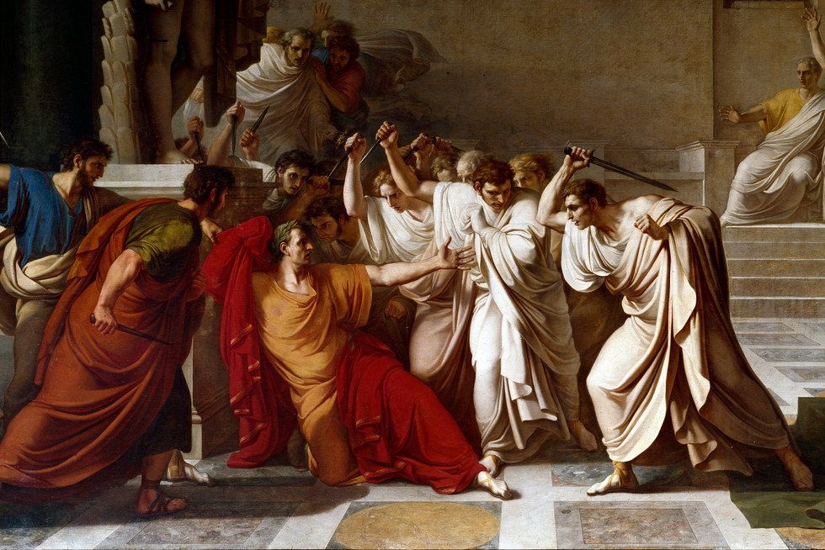
Rome – Social Structures
GOAL/S: Identify and describe Roman Social Structures
Week 2, Lesson 1

Slide 2
REVIEW – Ancient Rome
RETEACH
INSTRUCTIONS: Read the following bold and underlined words aloud as a class
_________________________________________________________________________________
According to legend, Rome was founded in 753 BCE by Romulus and Remus. Archaeological evidence of settlement around Rome starts to emerge around 1000 BCE.
Three important features of Roman Geography include:
The Tiber River which provided access to travel, trade, and conquering.
The Apennine Mountain Range which provided protection and defence.
Access to farming land at the base of the hill provided nutrient-rich soil.

Slide 3
REVIEW – Ancient Rome
RETRIEVE
INSTRUCTIONS: Write what the following words mean:
_________________________________________________________________________________
Patrician:_____________________________
Plebian:______________________________
Imperium:____________________________
Auctoritas:____________________________
Nobiles:______________________________
Liberti:_______________________________

Slide 4
REVIEW – Ancient Rome
RETRIEVE
INSTRUCTIONS: Write what the following words mean:
_________________________________________________________________________________
Patrician: Upper class/wealthy
Plebian: Middle/lower class
Imperium: Power
Auctoritas: Authority
Nobiles: Descendant of Consuls
Liberti: Freemen/Free Non-citizens

Slide 5
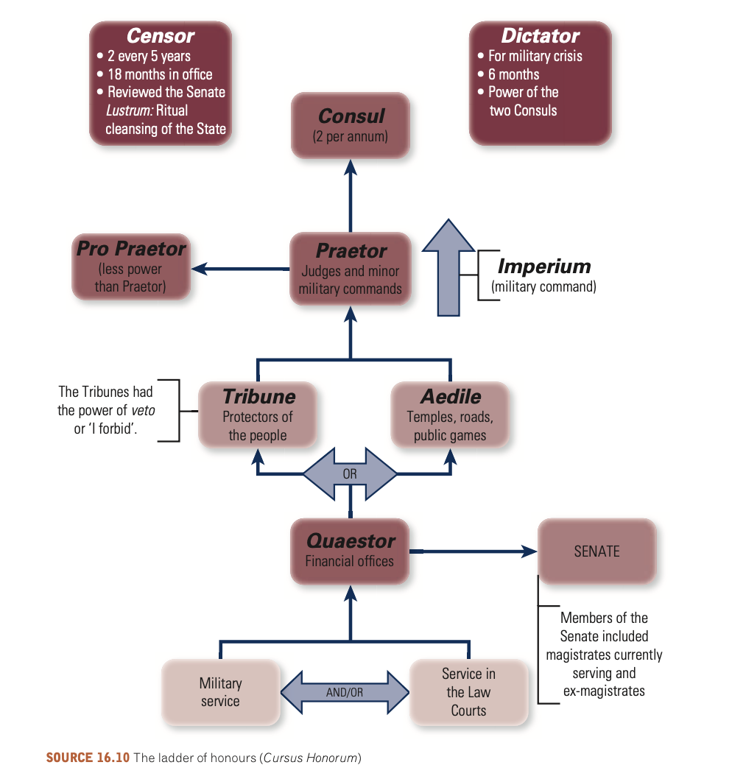
REVIEW – Ancient Rome
1.
2.
APPLY
3.
4.
INSTRUCTIONS: Try to fill in the diagram!
5.
6.

Slide 6
REVIEW – Ancient Rome
1.
APPLY
2.
3.
INSTRUCTIONS: Try to fill in the diagram!
4.
5.
6.

Slide 7

This week:
Roman SOCIAL structures
Roman CULTURAL features
Roman RELIGIOUS features
REVIEW – Week 2

Slide 8
The Ancient Roman Society, one of the most impressive civilizations in history, was a sophisticated web of intricate social structures and dynamic cultural innovations that governed its existence for over a thousand years (753 BCE - 476 CE). From the humble origins of a small town on the banks of the Tiber River, Rome expanded into an empire encompassing much of Europe, North Africa, and the Near East, establishing itself as a beacon of law, engineering, military might, and governance.

Slide 9
Social Structures
SUMMARISE THE FOLLOWING
Hierarchical with clear divisions between social classes.
At the apex stood the Patricians, a group of aristocratic families who traditionally held the highest political, religious, and military positions.
The Equestrians (or Equites) originally composed of wealthy non-patrician citizens whose main qualification was their ability to afford a horse for military service.
Over time, this class became an influential force in business and administration.
The Plebeians represented the common citizens in Rome, including artisans, merchants, farmers, and laborers.
While they initially had limited rights and political influence, they gradually secured more privileges, including the ability to hold the political office, following the ”Struggle of the Orders" in the 5th-4th centuries BC.
Slaves were acquired through conquests and performed all manner of work, from household chores to manual labour in the mines and fields.
In addition to these main classes, foreigners and freed slaves (Liberti) also played notable roles in Roman society.

Slide 10
ACTIVITY – Social Hierarchy
Copy the following into your book (full page)
8 levels

Slide 11
TEACHER ONLY
Emperor: Under the Empire, he was the most important person in the empire and could not be questioned.
Senators: A small group of men who wrote and discussed laws and rules in the senate. They were from wealthy families and wore a broad stripe on their toga to identify themselves.
Equestrians: These were upper/middle class men (often merchants or military men), described as 'knights'. They wore a narrow stripe on their toga to emulate the style of the senators.
Plebeians: This was the common class, including every freeborn male citizen. This included people from unskilled labourers, farmers, and sailors to tradesmen and merchants.
Latins: This class was similar to the Plebeians, expect it was for freeborn citizens born outside of Rome, in other parts of Italy. They had similar rights to a Roman citizen.
Foreigners: Any freeborn inhabitant of the vast Roman Republic/Empire outside of Italy was classed as a 'foreigner'. This class was only granted citizenship in the 3rd century CE.
Freedmen: This includes all enslaved people who had been liberated by their master. They had a few rights, but not many compared to a Roman citizen.
Enslaved people: This included the vast number of non-free members of Roman society. They were owned by a master and had no rights at all.

Slide 12
ACTIVITY – Social Hierarchy
Each of you will receive ONE (1) card.
You will be assigned a role in ‘Ancient Rome’.
Depending on which card you get, complete the following (3 minutes)
Glue the role in your book
Write 10 SEPARATE words which best describe that group
Be prepared to share your role and your words

Slide 13
Roman Citizenship
SUMMARISE THE FOLLOWING
Roman law was one of the most enduring legacies of Roman society, forming the basis for much of the Western legal tradition.
It was remarkably sophisticated, addressing a wide range of civil matters such as property rights, contracts, and family law.
Citizenship was highly coveted in Ancient Rome as it conferred a host of privileges, including voting rights, legal protection, and the right to hold public office.
The extension of citizenship to non-Romans played a significant role in the empire's expansion and cohesion.
In a landmark move, the Edict of Caracalla in 212 AD granted Roman citizenship to all free men within the empire.

Slide 14
ACTIVITY – Roman Citizenship
Read through the information sheet
Highlight key words
Define the key terms/words in your book
Describe roman citizenship in 20 - 30 words

